Slide 1
Fundamentals of Analysis of Algorithm Efficiency

Slide 2
General Plan for Recursive
Decide on input size parameter
Identify the basic operation
Does C(n) depends also on input type?
Set up a recurrence relation
Solve the recurrence or, at least establish the order of growth of its solution

Slide 3
Recurrences
The expression: is a recurrence.
Recurrence: an equation that describes
a function in terms of its value on
smaller functions

Slide 4
Recurrence Examples

Slide 5
Important Recurrence Types
One (constant) operation reduces problem size by one.
T(n) = T(n-1) + c T(1) = d
Solution: T(n) = (n-1)c + d linear
A pass through input reduces problem size by one.
T(n) = T(n-1) + cn T(1) = d
Solution: T(n) = [n(n+1)/2 – 1] c + d quadratic
One (constant) operation reduces problem size by half.
T(n) = T(n/2) + c T(1) = d
Solution: T(n) = c log n + d logarithmic
A pass through input reduces problem size by half.
T(n) = 2T(n/2) + cn T(1) = d
Solution: T(n) = cn log n + d n n log n

Slide 6
Order of Recurrence Relation
A recurrence relation is said to have constant coefficients if the f’s are all constants.
Fibonacci relation is homogenous and linear:
F(n) = F(n-1) + F(n-2)
Non-constant coefficients: T(n) = 2nT(n-1) + 3n²T(n-2)
Order of a relation is defined by the number of previous terms in a relation for the n^{th} term.
First order: S(n) = 2S(n-1)
n^{th} term depends only on term n-1
Second order: F(n) = F(n-1) + F(n-2)
n^{th} term depends only on term n-1 and n-2
Third Order: T(n) = 3nT(n-2) + 2T(n-1) + T(n-3)
n^{th} term depends on term n-1 and n-2 and n-3

Slide 7
Analysis of Recursive Algorithms
ALGORITHM F(n)
// Output: n!
if n = 0
return 1
else
return n×F(n-1)
Input size: n
Basic operation: ×
M(n) = M(n-1) + 1 for n > 0
to compute
F(n-1)
to multiply
n and F(n-1)

Slide 8
Analysis of Recursive (contd.)
M(n) = M(n-1) + 1
M(0) = 0
M(n) = M(n-1) + 1 = M(n-2)+ 1 + 1 = … …
= M(n-n) + 1 + … + 1 = 0 + n = n
We could compute it non-recursively, saves function call overhead
Recurrence relation
By Backward substitution
n 1’s

Slide 9
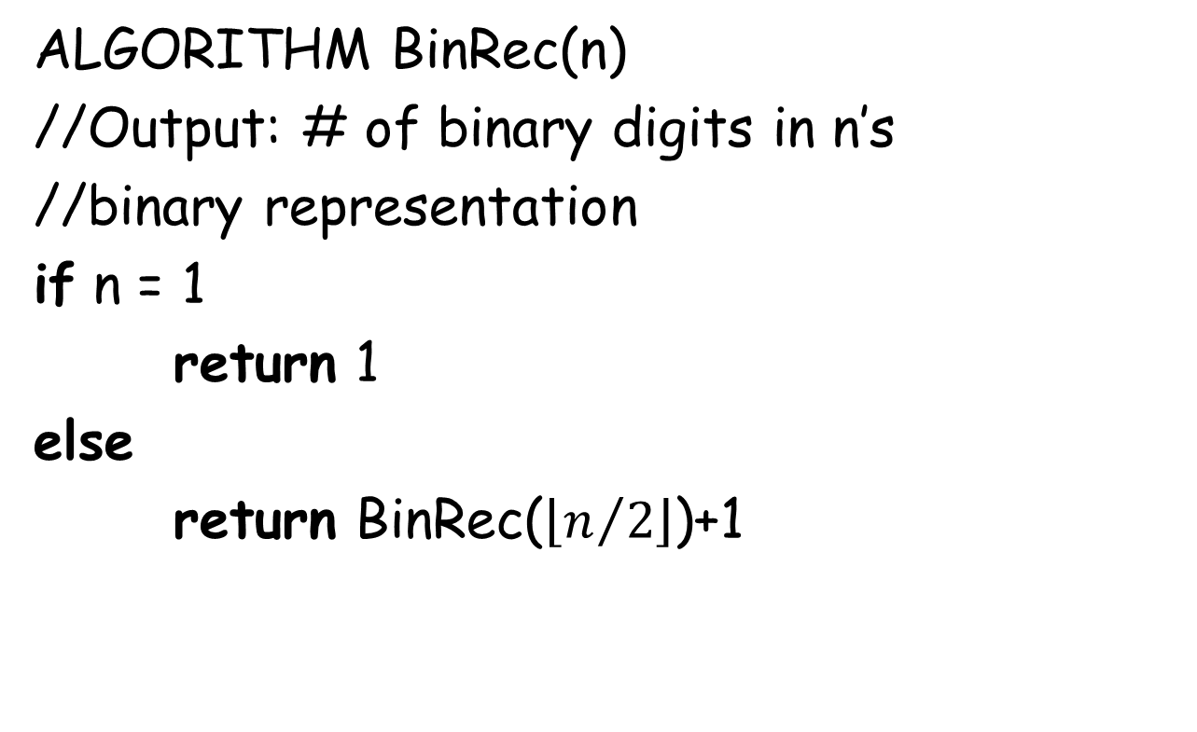
Analysis of Recursive (contd.)
ALGORITHM BinRec(n)
//Output: # of binary digits in n’s
//binary representation
if n = 1
return 1
else
returnBinRec($\left\lfloor n/2\right\rfloor$)+1
Input size: n = 2^{k}
Basic operation: +
A(n) = A(2^{k}) = A(2^{k-1}) + 1 = [A(2^{k-2}) + 1] + 1
= … = A(2^{k-k})+k = A(1) + k = k = lg(n)
A(n) є Θ(lg(n))

Slide 10
Analysis of Recursive (contd.): Tower of Hanoi

Slide 11
Tower of Hanoi (contd.)
M(n-1)
M(n) = M(n-1) + 1 + M(n-1)
M(1) = 1
1
M(n-1)

Slide 12
Tower of Hanoi (contd.)
ALGORITHM ToH(n, s, m, d)
if n = 1
print “move from s to d”
else
ToH(n-1, s, d, m)
print “move from s to d”
ToH(n-1, m, s, d)
M(1) = 1
M(n-1)
M(1)
M(n-1)

Slide 13
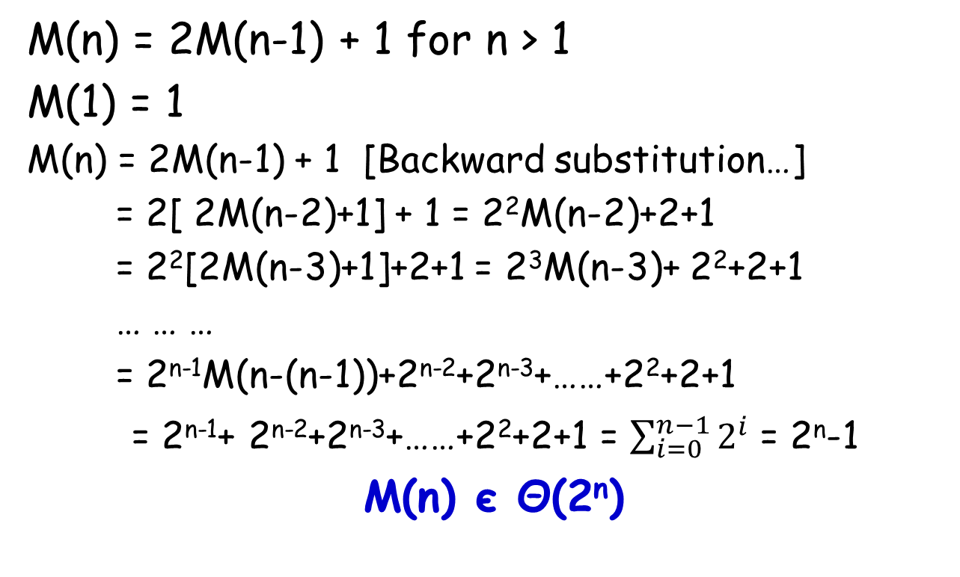
Tower of Hanoi (contd.)
M(n) = 2M(n-1) + 1 for n > 1
M(1) = 1
M(n) = 2M(n-1) + 1 [Backward substitution…]
= 2[ 2M(n-2)+1] + 1 = 2²M(n-2)+2+1
= 2²[2M(n-3)+1]+2+1 = 2³M(n-3)+ 2²+2+1
… … …
= 2^{n-1}M(n-(n-1))+2^{n-2}+2^{n-3}+……+2²+2+1
= 2^{n-1}+ 2^{n-2}+2^{n-3}+……+2²+2+1 = $\sum_{i=0}^{n−1}{2^{i}}$ = 2^{n}-1
M(n) єΘ(2^{n})
Be careful! Recursive algorithm may look simple
But might easily be exponential in complexity.

Slide 14
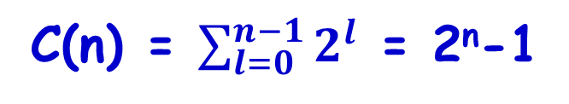
Tower of Hanoi (contd.)
Recursion tree (# of function calls)
n
n-1
n-1
n-2
n-2
n-2
n-2
…
…
…
2
2
2
2
1
1
1
1
1
1
1
1
C(n) = $\sum_{l=0}^{n−1}{2^{l}}$ = 2^{n}-1

Slide 15
Find the solution for the following recurrence relation:
T(1) = 1
T(n) = T(n-1) + 3 for n ≥ 2
Solution:
T(n) = T(n-1) + 3
= [T(n-2)+3] + 3
= T(n-2)+2*3
= [T(n-3)+3] + 2*3 = T(n-2) + 3*3 In general, we guess t
= ..
…
T(n) = T(n-k) + k*3
Make T( n-k) as Initial Condition

Slide 16
Make T( n-k) as Initial Condition T(1) = 1
For that take n-k = 1, i.e. k = n-1
T(n) = T(1) + (n-1)*3 = 1 + (n-1)*3 = 3*n-2
Prove the above by induction: T(1) = 3(1)-2 = 1, true
Assume T(k) = 3*k-2, show T(k+1) = 3*(k+1) +1 = 3*k+1
T(k+1) = T(k) + 3 from the given recurrence relation
T(k+1) = 3*k-2+3 by inductive hypothesis
Hence, T(k+1) = 3*k+1

Slide 17
Analysis of Recursive (contd.)
Maximum how many slices of pizza can a person obtain by making n straight cuts with a pizza knife?
L₀ = 1
L₁ = 2
L₂ = 4
1
2
3
difference
L₃ = 7
1, 2, 4, 7, …
L_{n} = L_{n-1} + n for n > 0
L₀ = 1
Bonus problem in HW2

Slide 18
Analysis Of Recursive Binary Search
public int binarySearch (int target, int[] array,int low, int high)
{
if (low > high)
return -1;
else
{
int middle = (low + high)/2;
if (array[middle] == target)
return middle;
else if(array[middle] < target)
return binarySearch(target, array, middle + 1, high);
else
return binarySearch(target, array, low, middle - 1);
}
}

Slide 19
Analysis Of Recursive Binary Search
The recurrence relation for the running time of the method is:
T(1) = a if n = 1 (one element array)
T(n) = T(n / 2) + b if n > 1

Slide 20
Analysis Of Recursive Binary Search (Cont’d)
Without loss of generality, assume n, the problem size,
is a multiple of 2, i.e., n = 2^{k}
Expanding:
T(1) = a (1)
T(n) = T(n / 2) + b (2)
= [T(n / 2²) + b] + b = T (n / 2²) + 2b b y substituting T(n/2) in (2)
= [T(n / 2³) + b] + 2b = T(n / 2³) + 3b by substituting T(n/2²) in (2)
= ……..
= T( n / 2^{k}) + kb
The base case is reached when n / 2^{k} = 1 ➔ n = 2^{k} ➔ k = log₂n,
we then have:
T(n) = T(1) + b log₂ n
= a + b log₂ n
Therefore, Recursive Binary Search is O(log n)

Slide 21
EXAMPLE: nth Fibonacci Number
0, 1, 1, 2, 3, 5, 8, 13, 21, 34, …
F(n) = F(n-1) + F(n-2) for n > 1
F(0) = 0, F(1) = 1
Let’s try backward substitution…
F(n) = F(n-2)+F(n-3)+F(n-3)+F(n-4)
= F(n-2)+2F(n-3)+F(n-4)
= F(n-3)+3F(n-4)+3F(n-5)+F(n-6) …

Slide 22
nth Fibonacci (contd.)
ax(n)+bx(n-1)+cx(n-2) = 0
Homogeneous linear second-order recurrence with constant coefficients
Guess: x(n) = r^{n}
ar^{n}+br^{n-1}+cr^{n-2} = 0
ar²+br+c = 0
THEOREM: If r₁, r₂ are two real distinct roots of characteristic equation then
x(n) = αr₁^{n}+βr₂^{n} where α, β are arbitrary constants
Characteristic equation

Slide 23
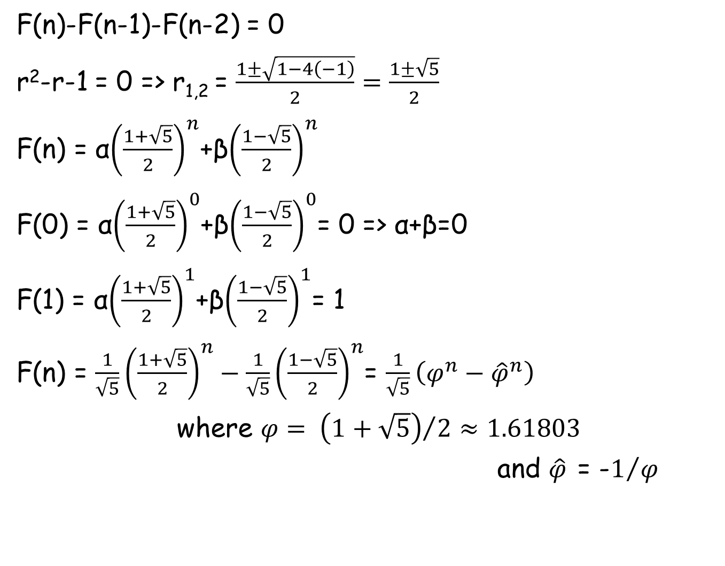
nth Fibonacci (contd.)
F(n)-F(n-1)-F(n-2) = 0
r²-r-1 = 0 => r_{1,2} = $\frac{1±\sqrt{1−4\left(−1\right)}}{2}=\frac{1±\sqrt{5}}{2}$
F(n) = α${\left(\frac{1+\sqrt{5}}{2}\right)}^{n}$+β${\left(\frac{1−\sqrt{5}}{2}\right)}^{n}$
F(0) = α${\left(\frac{1+\sqrt{5}}{2}\right)}^{0}$+β${\left(\frac{1−\sqrt{5}}{2}\right)}^{0}$= 0=>α+β=0
F(1) = α${\left(\frac{1+\sqrt{5}}{2}\right)}^{1}$+β${\left(\frac{1−\sqrt{5}}{2}\right)}^{1}$= 1
F(n) = $\frac{1}{\sqrt{5}}{\left(\frac{1+\sqrt{5}}{2}\right)}^{n}−\frac{1}{\sqrt{5}}{\left(\frac{1−\sqrt{5}}{2}\right)}^{n}$= $\frac{1}{\sqrt{5}}\left(φ^{n}−{\hat{φ}}^{n}\right)$
where $φ= {\left(1+\sqrt{5}\right)}/2≈1.61803$
and $\hat{φ}$ = -$1/φ$

Slide 24
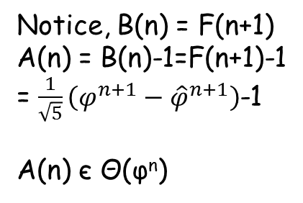

nth Fibonacci (contd.)
F(n) = $\frac{1}{\sqrt{5}}\left(φ^{n}−{\hat{φ}}^{n}\right)$ where $φ$ ≈ 1.61803 and $\hat{φ}$ ≈ -0.61803
F(n) єΘ(φ^{n})
ALGORITHM F(n)
if n ≤ 1
return n
else
return F(n-1)+F(n-2)
A(n) = A(n-1)+A(n-2)+1
A(0) = 0, A(1) = 0
[A(n)+1] –[A(n-1)+1]-[A(n-2)+1]=0
Let B(n) = A(n)+1
B(n) –B(n-1)-B(n-2)=0
B(0)=1, B(1)=1
Notice, B(n) = F(n+1)
A(n) = B(n)-1=F(n+1)-1
= $\frac{1}{\sqrt{5}}\left(φ^{n+1}−{\hat{φ}}^{n+1}\right)$-1
A(n) єΘ(φ^{n})
Basic op: +

Slide 25
nth Fibonacci (contd.)
F(5)
F(4)
F(3)
F(3)
F(2)
F(2)
F(1)
F(2)
F(1)
F(1)
F(0)
F(1)
F(0)
F(1)
F(0)
Only n-1 additions, Θ(n)!
ALGORITHM Fib(n)
F[0] <- 0
F[1] <- 1
for i <- 2 to n do
F[i] <- F[i-1]+F[i-2]
return F[n]
ALGORITHM Fib(n)
f <- 0
fnext <- 1
for i <- 2 to n do
tmp <- fnext
fnext <- fnext+f
f <- tmp
return fnext

